Slide 1
SODV1201: Introduction to Web Programming
SUMMER 2024
Michael Dorsey

Slide 2
Welcome to class
Land acknowledgement
About me
About you
Name
Where are you from?
Which diploma program are you in?
Career aspirations (if any)
Fun fact about yourself

Slide 3
Expectations
Attend each class
Be on-time.
Important announcements are made at the beginning of class.
Come prepared
Read course materials before class.
Have questions ready.
Complete all Learning Activities.
Be engaged
Ask and answer questions.
Speak up.
Collaborate with classmates.

Slide 4
Academic Honesty and Integrity
Plagiarism is not allowed.
Use proper citations for any outside material.
Collaborating with classmates is allowed for out-of-class assessments.
But everyone must submit their own personal work.
Collaborating with classmates is not allowed for in-class and timed assessments (e.g. quizzes, exams).
Use of generative AI is allowed if its properly referenced. See the “AI Policy” for more details.

Slide 5
Communication
Best way to contact me is on Microsoft Teams. Start a one-on-one chat with me.
Can also email me at mdorsey@bowvalleycollege.ca

Slide 6
Technology
Microsoft Teams
Used for normal class meetings
I REALLY like it when students turn on their camera.
Raise hand to speak
Mute microphone when not speaking
Channels:
General – used by instructor for general news about the course.
Chat Room – where students can discuss any course-related topics.
Meetings and Recordings - where class meetings take place, and where recordings will be posted.

Slide 7

Technology
D2L / Brightspace
News: notices and weekly update
Course content
Assessments
Quizzes, assignments, GLAs, project
Submissions
Calendar

Slide 8
D2L Shell
Course Outline
Course Information:
Course Offering Information
Assignments Policy
AI Policy
Assessments Schedule
You are responsible for reviewing and following these important items!
Class Slideshows
Class Resources
Modules
Assessments
Notes:
ChatGPT example: “In JavaScript, write me a function that produces a random number between 1 and 6.“

Slide 9

Questions?

Slide 10
Classroom Agreement
What expectations do we all have (instructor and learners) for this semester?
What kind of actions can we take to ensure that everyone feels welcome and respected?
What does a great classroom look, sound, and feel like?
How can we set ourselves up for success this semester?
Document will be saved in D2L > Course Information.
Notes:
Group activity

Slide 11
Course Outline
Module 1: Fundamentals of JavaScript Programming
DOM, objects, error handling
Functions
Arrays
Module 2: jQuery
Module 3: Modern Web App Architecture and Development
Module 4: Introduction to Node.js
Module 5: Full Stack Web Development
Express
Back-end programming
Web security

Slide 12
Course Pre-Assessment
Course description: “This course provides learners with foundational web programming knowledge and skills. Learners focus on basic to advanced JavaScript programming to build dynamic web application and use it as a backend scripting language with one of the modern JavaScript library node.js. Also, learners explore the concept of web application architecture and other JavaScript libraries like jQuery and Node.js Packages throughout the course and build a basic full stack application.”
Pre-requisites: TECH1101 and SODV1101.
Think about your current knowledge and experience with web programming and software development in general.
How comfortable are you with the JavaScript language? How would you rate your skills on a scale from 1 – 10?
Do you know the difference between the “front-end” and “back-end” of software applications?
Do you know what a “full-stack web application” is?
What do you know about jQuery? Have you ever used it? If so, in what ways?
What do you know about Node.js? Have you ever used it? If so, in what ways?
Write down in your notes anything you know about our course topic. Save it somewhere safe, we will revisit these at the end of the semester.
Notes:
THINK - SHARE

Slide 13
Goal Setting
What goals do you have for this course? What do you hope to accomplish by the last day of this semester?
Why are you here? What do you want to do with this degree you are working towards?
Think about how much money you are spending on this class. How best can you make use of this investment?
What will stop or derail you from meeting these goals? And how can you resolve that now?
Write down at least 1 goal in your notes. Save it somewhere safe, we will revisit these goals at the end of the semester.
Notes:
THINK - SHARE

Slide 14
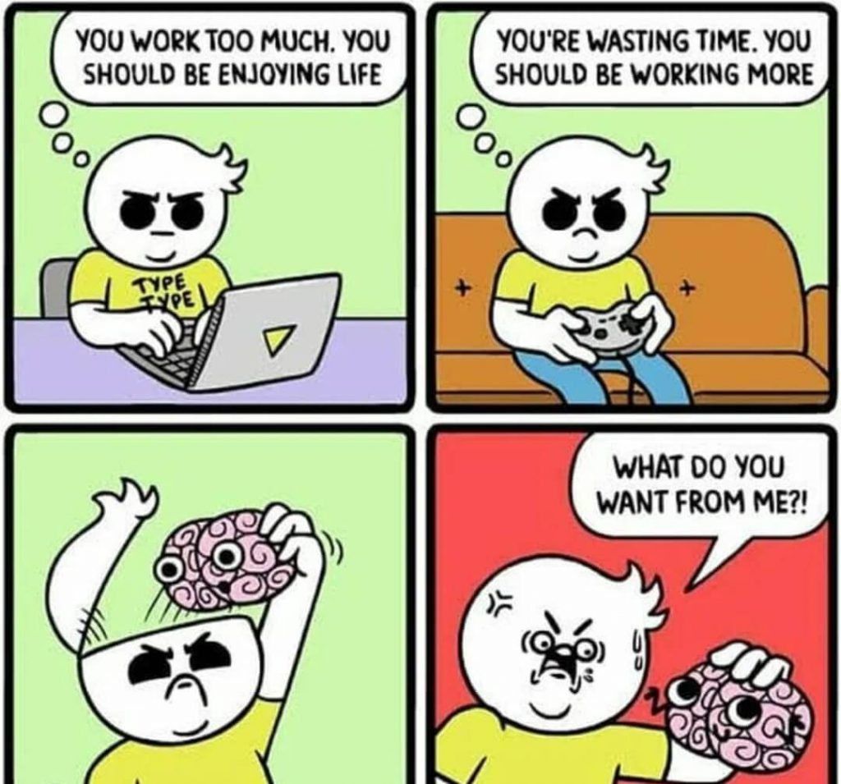
Tips to becoming a great programmer
Becoming a good programmer takes practice. You should be writing code every day!
Take frequent breaks and adequate sleep. Sometimes the best way to fix a bug is to walk away!
Don’t be afraid or ashamed of writing “broken” code. Experimentation is the best way to learn.
Focus on progress instead of aiming for perfection.
Become an expert debugger:
Use debugger tools.
Use print/log statements.
Use Stack Overflow, Google, AI (but make sure to cite it!).
Rubber Duck Debugging.
Get help from peers and the instructor.

Slide 15
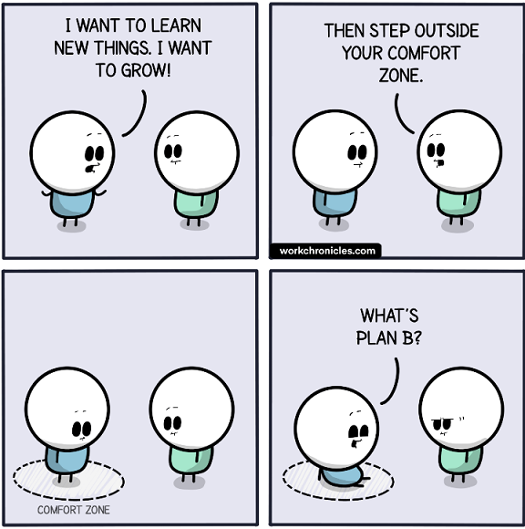
Imposter Syndrome
What is imposter syndrome?
What is imposter syndrome and how can you combat it?
Why are developers prone to imposter syndrome?
A workplace survey found that 58% of tech workers feel like impostors.
Have you ever experienced imposter syndrome?
What are the negative impacts (in education, career, personal growth) of imposter syndrome?
What steps can you take to manage these feelings?
Notes:
My experience: first time as a mentor at a development bootcamp.
THINK-PAIR-SHARE

Slide 16
Setup your development environment
This is Learning Activity 1.1.1.
Download and install Visual Studio Code
Install the “Live Server” extension
Download Node.js
Here is a VS Code <> Node.js tutorial: https://code.visualstudio.com/docs/nodejs/nodejs-tutorial
Create a CodePen account

Slide 17
For next class
Read Lesson 1.1
Do Learning Activities 1.1.1, 1.1.2, 1.1.3, 1.1.4.
Declare any preferences for members of your group project by July 9 (max 3 people in a group).
Assessments Reminder:
All assessment dates have been posted in D2L.
See the “Assignments Policy” for late submission procedures.

Slide 18
References
https://levelup.gitconnected.com/10-hilarious-programming-jokes-to-make-you-laugh-hard-9959cbdccb47
https://www.turing.com/blog/programmer-imposter-syndrome-tips/#prone
https://devdojo.com/fun
https://www.teamblind.com/blog/58-percent-of-tech-workers-feel-like-impostors/

